Slide 1
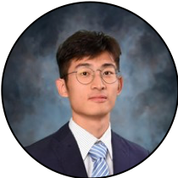
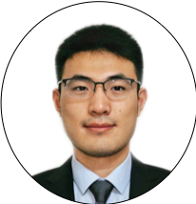
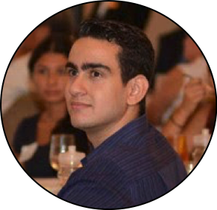
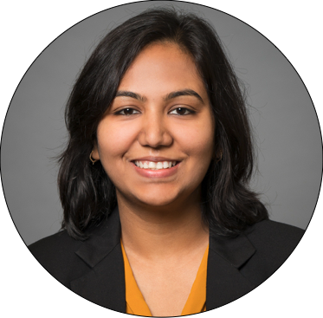
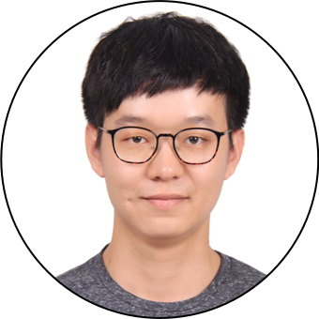
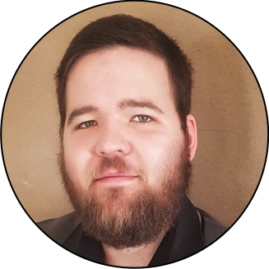
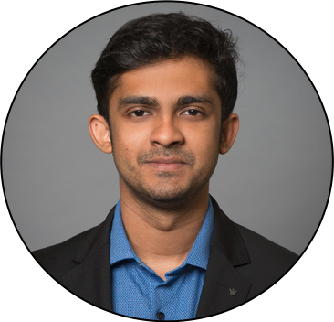
Cornell Tech & Samsung
Team BlueMoon
Jiacheng Dong
ORIE
James Chen
ORIE
Christian Rodriguez
CS
Mansi Garg
MBA
Harry Li
ORIE
Frans Fourie
ECE
Alan Abraham
MBA

Slide 2
Opportunities
Samsung is a seniority-oriented big-co which needs a way to allow free-flow of ideas as it tries to shift to a startup culture

Slide 3
Challenges
Changing Company Culture Requires a Movement

Slide 4
Hypothesis
In order to create a start-up culture, we need to enable free-flow of ideas.

Slide 5
What we will do
Problem - Boundaries for Ideas
Cultural
Geographical
Structural
Lingual
Solution - An Idea Validation Platform
Anonymous & Expertise-based
Online
Flat-hierarchical voting
Auto-translate

Slide 6
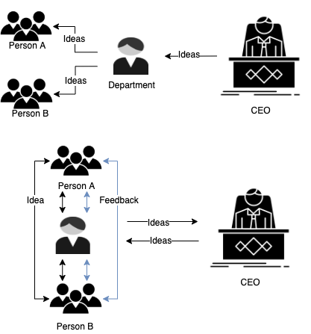
What we will do

Slide 7
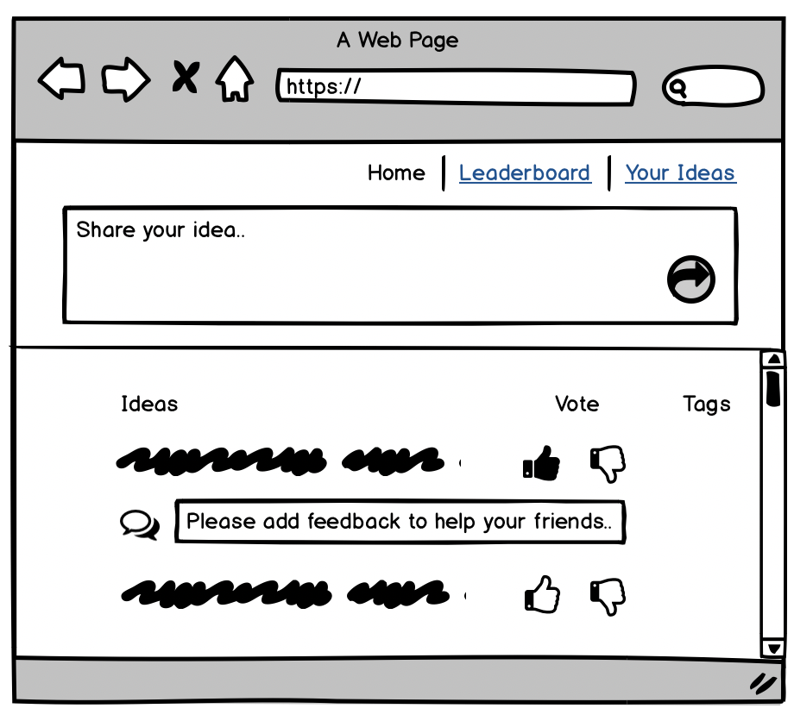
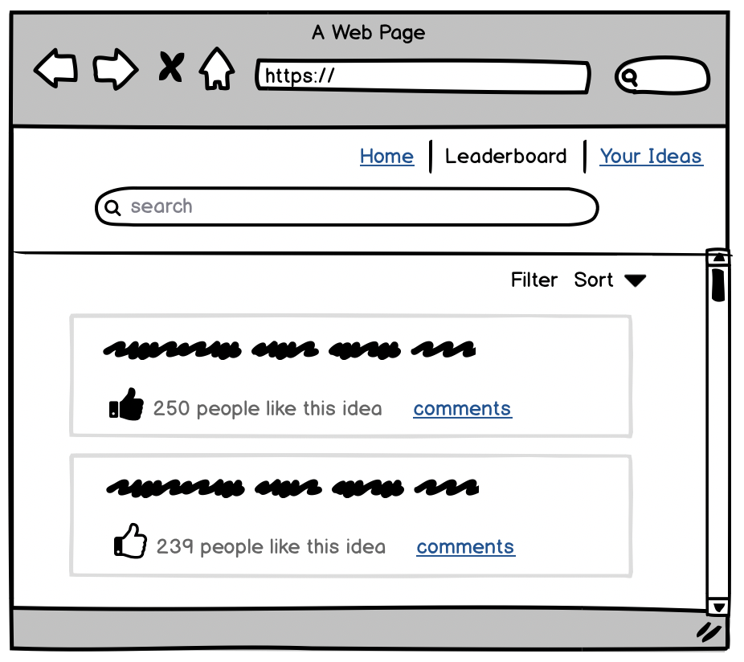
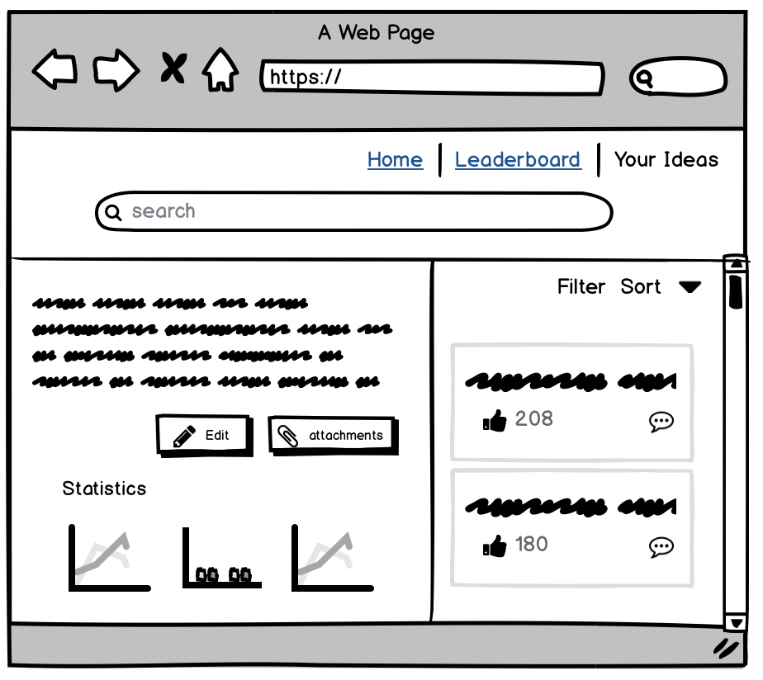
Samsung Reach

Slide 8



Potential risks
Participation
Awards
Anonymity

Slide 9


Mitigation steps
Week 1
Week 2

Slide 10


Future Challenges
Technical
Non-technical

Slide 11
Thank you

Slide 12
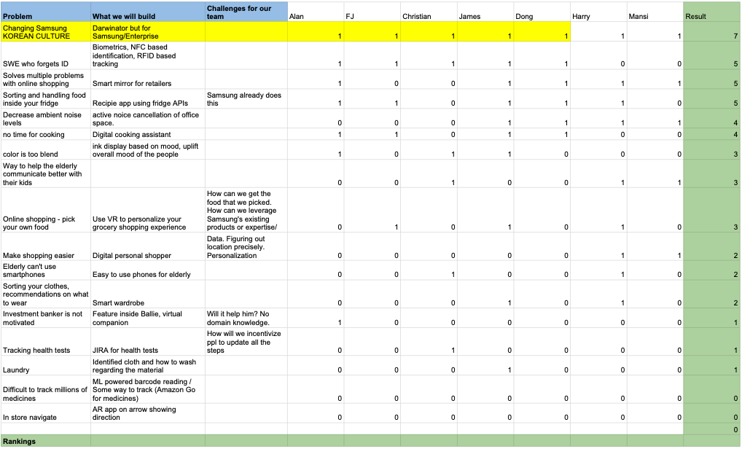
Appendix
Idea Filtering

Slide 13
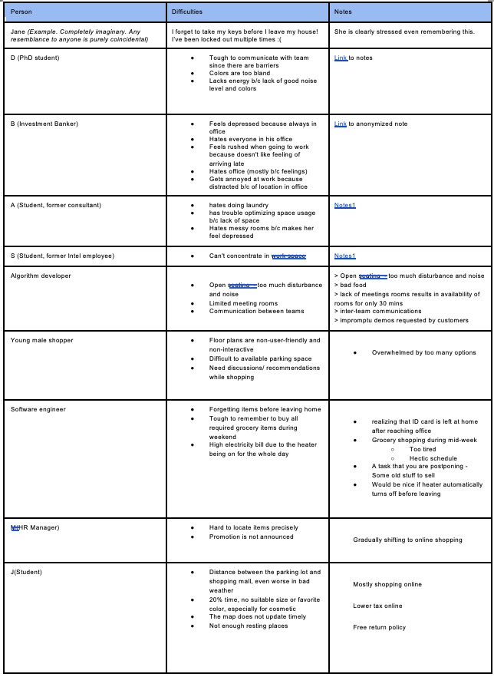
User Interview part 1

Slide 14
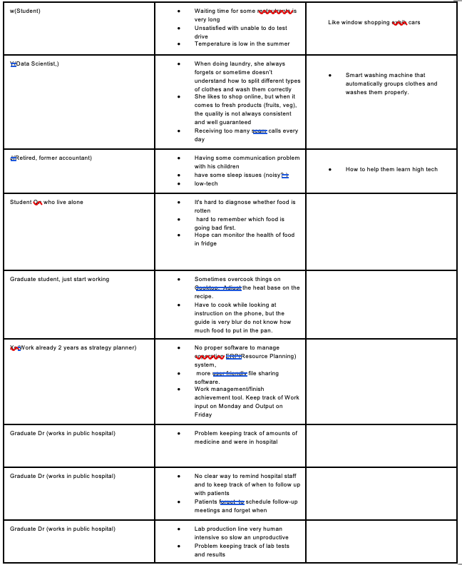
User Interview part 2

